Slide 1
MVC AND JSP MODELS
Instructor:

Slide 2
Table Content
What Is a MVC?
Web Application MVC Pattern
Model
View
Controller
JSP Model 1, 2

Slide 3
Learning Goals
After the course, attendees will be able to:
Understand MVC - JSP Models
Can use MVC – JSP Models to build Project

Slide 4
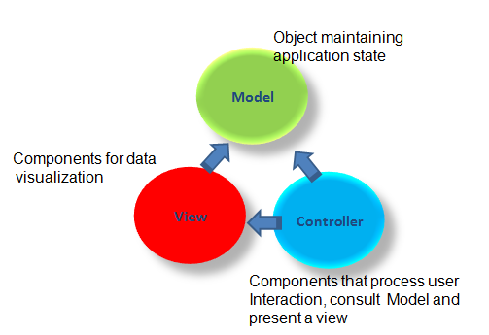
What Is a MVC?
MVC stands for Model / View / Controller.
A software pattern where logic is separated from the model and view in order to provide for better reuse possibilities.
A software pattern recognized in the early days of small talk.
MVC Architecture

Slide 5
Web Application MVC Pattern
1
Controller (Servlet)
Model:
Information is provided in objects or beans
View:
The JSP provide the view
Controller:
Servlet provides control logic and becomes the controller
2
Model (Beans)
3
View (JSPs)
4
View (JSPs)
5
View (JSPs)
View (JSPs)
View (JSP)

Slide 6

MVC - Model
The model is responsible for managing the data of the application.
Manages Information - If Changes
Maps Real-World Entities
Contains data and Related Functionality
Performing DB Queries
Calculating Business Process
Encapsulates Domain Logic which are independent of Presentation

Slide 7

MVC - View
Obtains data from model & presents to the user
Represents Output/Input of the application
Display results of Business Logic
Free Access to Model
Reads Data from Model – Using Query Methods

Slide 8
MVC - Controller
Serves logical connection between user’s interaction and the business process
It receives and translates input to request on model or view
Input from user and instructs^{[chỉ thị]} the model and view to perform action
Responsible for making decision among multiple presentation
Maps the end-user action to the application response

Slide 9
Relationship between Components
View and Controller
Controller is responsible for creating or selecting view
Model and Controller
Controller depends on model
If a change is made to the model then there might be required to make parallel changes in the Controller
Model and View
View depends on Model
If a change is made to the model then there might be required to make parallel changes in the view

Slide 10
Logical Layers in Web Application
public class DbBean{
public string userName { get; set; }
public string password { get; set; }
…
}
Model
<form method="post" action="Login">
<input type="text" name="txtUserName"></td>
<input type="text" name="txtUserName"></td>
…
<td>${u.userName} </td>
<td>${u.userPassword} </td>
View
protected void processRequest(HttpServletRequest request, HttpServletResponse response)throws ServletException, IOException {
String userName = request.getParameter("txtUserName");
String userPassword = request.getParameter("txtPassword");
User u = new User();
UserBO ubo = new UserBO();
u.setUserName(userName);
u.setUserPassword(userPassword);…
Controller

Slide 11
MVC Collaboration Diagram

Slide 12
Java 2 Web Applications
Java 2 web application options:
Servlets
Great for Java people
Difficult to manage graphical changes in HTML layout.
JSP
Great for web developers
Seductive tendency to write logic in the JSP page.

Slide 13
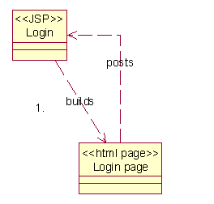
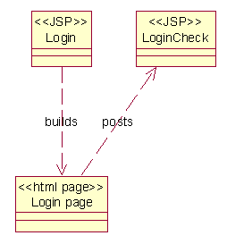
JSP Model
Web applications where JSP pages are used for every aspect of the development.
Option 1
Option 2

Slide 14
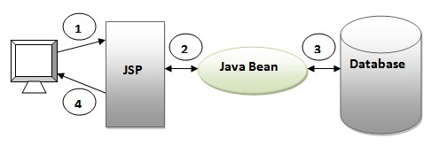
JSP Model 1
A request is made to a JSP or servlet
The JSP or servlet handles all responsibilities for the request
processing,
validating data,
handling the business logic,
and generating a response

Slide 15
JSP Model 1 Observation
The Good
Easiest Solution
The Bad
Presentation and Logic are mixed.
The Ugly
No reuse possibilities
JSP1
JSP3
JSP2
JSP4
Presentation
Logic
Ctrl
Presentation
Presentation
Logic
Ctrl
Present.
Logic
Present.

Slide 16
JSP Model 1 Observation (cont.)
Advantages
Lightweight design – for small, static application
Suitable for small applications having very simple page flow, little need for centralized security control and logging.
Limitations
Navigation Problem – to change name of JSP file have to change in many location
Applications are difficult to modify – large Java code being embedded in JSP page
Not suitable for large and complex applications

Slide 17
JSP Model 2
Web applications where JSP pages are used for the GUI aspect of the web development
The logic of the application is placed in the servlets it posts to.
DAO

Slide 18
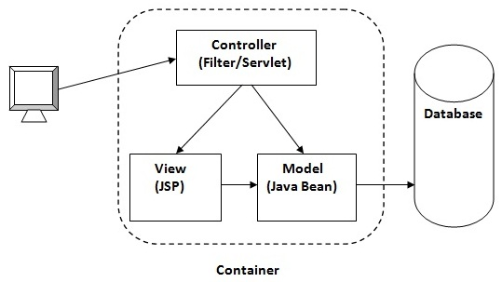
JSP Model 2
Model 2 separates the display of content from the logic used to obtain and manipulate the content.
Advantages:
Easier to build, maintain and extend: Suitable for large and complex applications.
Single point of control (Servlet) for security and logging.
Limitations: Increase Design Complexity

Slide 19
JSP Model 2 – Observation
The Good
Reuse opportunities: Other application may be able to use the same code.
The Bad
There is no longer a one to one mapping from a view to a single source of code.
The Ugly
Takes more forethought.
Logic
Control
JSP1
JSP3
JSP2

Slide 20
Summary
What Is a MVC?
Web Application MVC Pattern
Model
View
Controller
JSP Model 1, 2

Slide 21

Thank you
21

